Slide 1
Who goes there?
Threat Hunting on your home network
Scott Lynch
Bucks County Community College
Focus on Security 2021

Slide 2

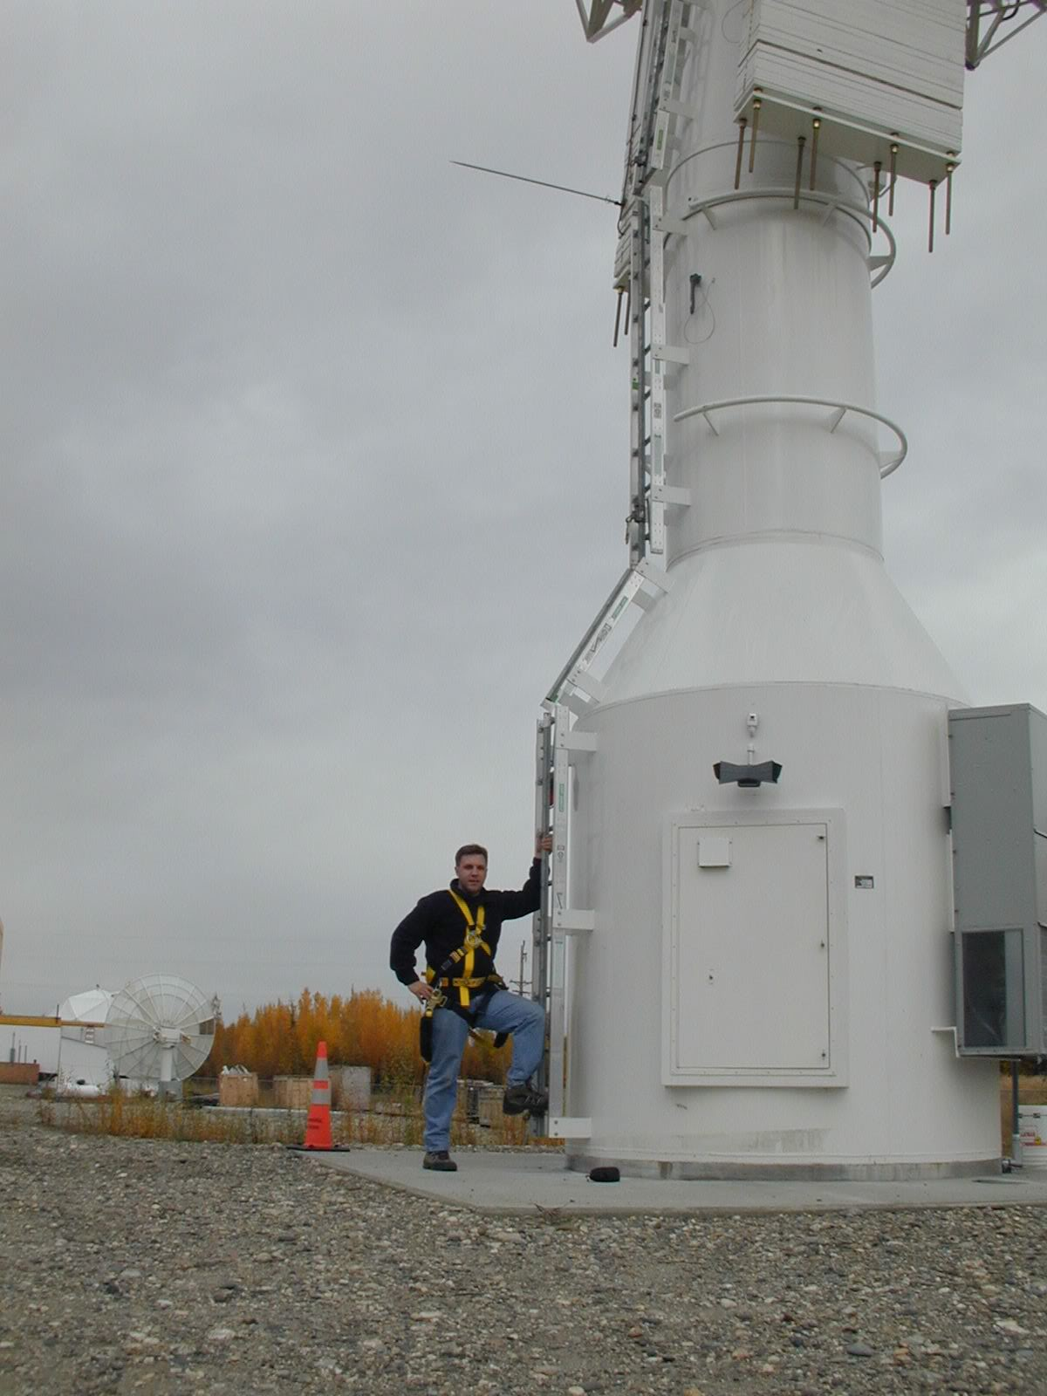






About Me
Scott Lynch @packetengineer
Lynch@packetengineer.com
Instructor SANS SEC555: SIEM with Tactical Analytics
Cisco and NSM Instructor WITAC 2118 and 2122, BCCC
Manager Security Operations, Global Aerospace Company
US Navy Veteran, Electronic Warfare/Information Warfare
GCDA, GDSA, GCIH, GNFA

Slide 3
“NSM is the collection, detection, and analysis of network security data.”
Chris Sanders
Author Applied Network Security Monitoring

Slide 4
Why do we need NSM?
Malware
Spyware
Viruses
Trojans
Worms
Phishing scams
Ransomeware

Slide 5

Visibility and Awareness
Network Assets
Network Traffic
Meta Data
Threat Hunting
Threat Intel

Slide 6













Typical Home Network

Slide 7
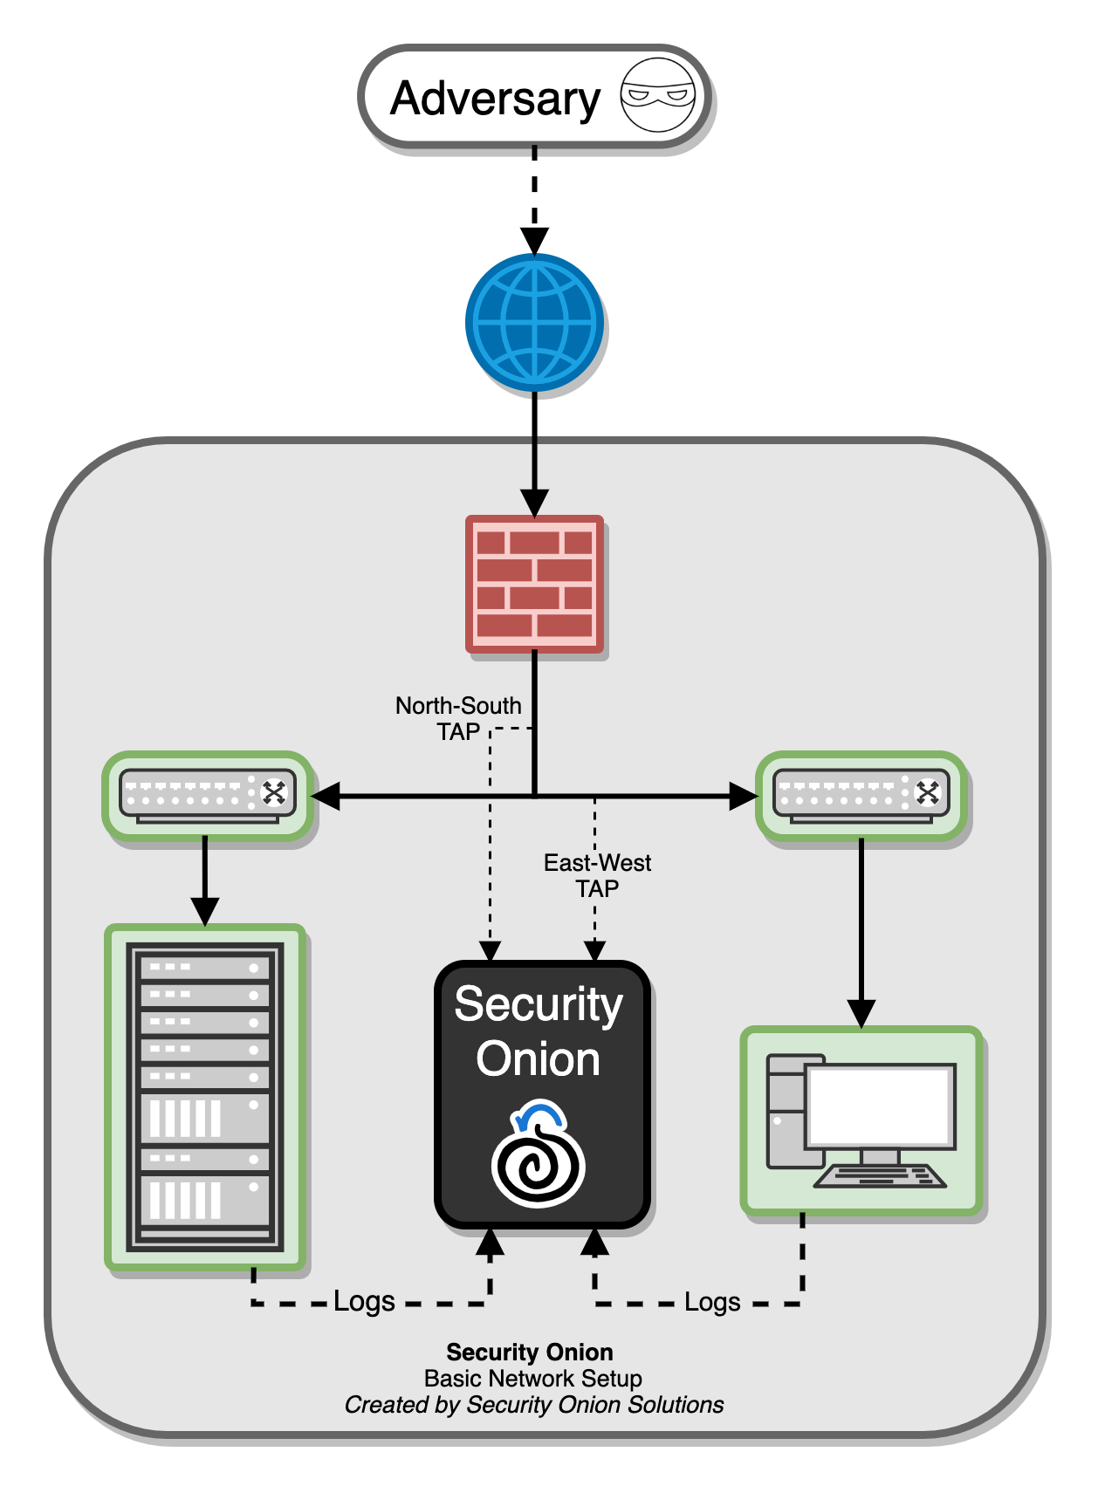
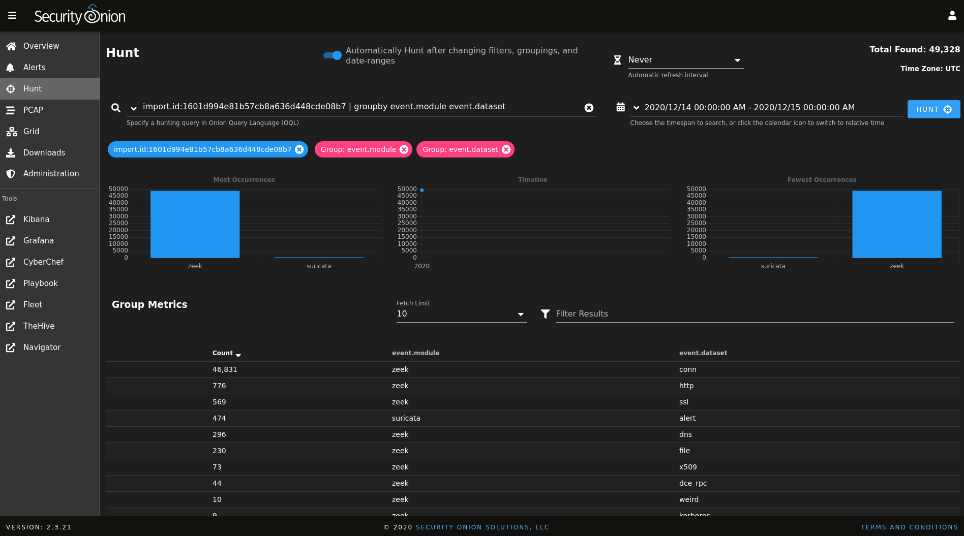

Security Onion
Free and open Linux distribution for threat hunting, enterprise security monitoring, and log management.
It includes
TheHive
Playbook
Fleet
osquery
CyberChef
Elasticsearch
Logstash
Kibana
Suricata
Zeek
Wazuh
and many other security tools

Slide 8
Benefits of Security Onion
Full Packet Capture
Netlfow
Intrusion Detection
Windows Event Logs
Syslog
Zeek Metadata
Threat Intel
Host Activity and Visibility
Early Warning and Detection
Connections | DHCP | DNS | DPD | Files
FTP | HTTP | IRC | Kerberos | Notice
RDP | Signatures | SMTP | SNMP | Software
SSH | SSL | Syslog | Tunnel | Weird
MySQL | SOCKS | x509

Slide 9
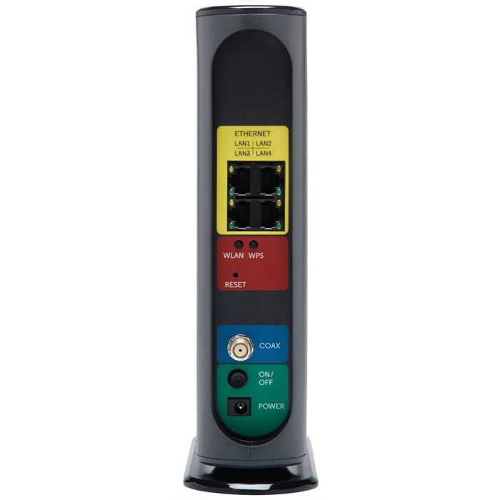
Home Network Components
Multifunction Device
NAT Firewall
Router
Wireless AP
Ethernet Switch
DHCP Server
Security Device
Wireless Cable or Fiber Modem

Slide 10
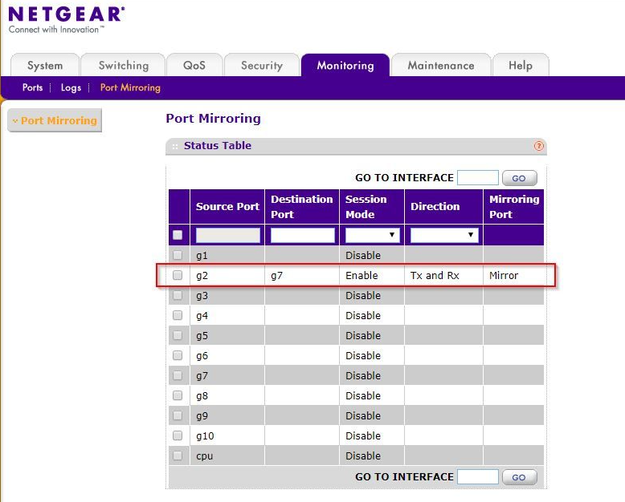
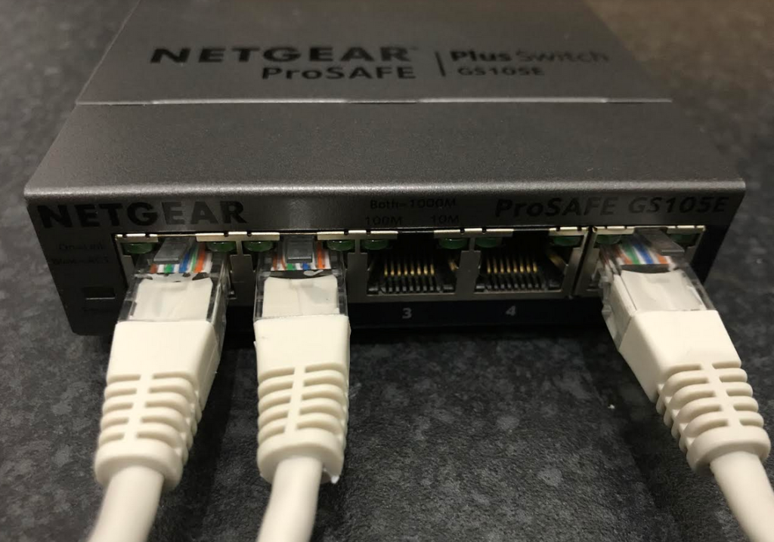
Port Mirroring or SPAN Port
Used to copy network traffic from one port to another for monitoring
Cisco SPAN
Port Mirroring
ISP
Home Wifi
Monitor Port
https://youtu.be/2RRFzyByh1U

Slide 11



Monitoring the Home Network
Before
After
New WAP
Monitoring Switch
Laptop/Desktop/NUC/Raspberry Pi
Internet
Internet

Slide 12
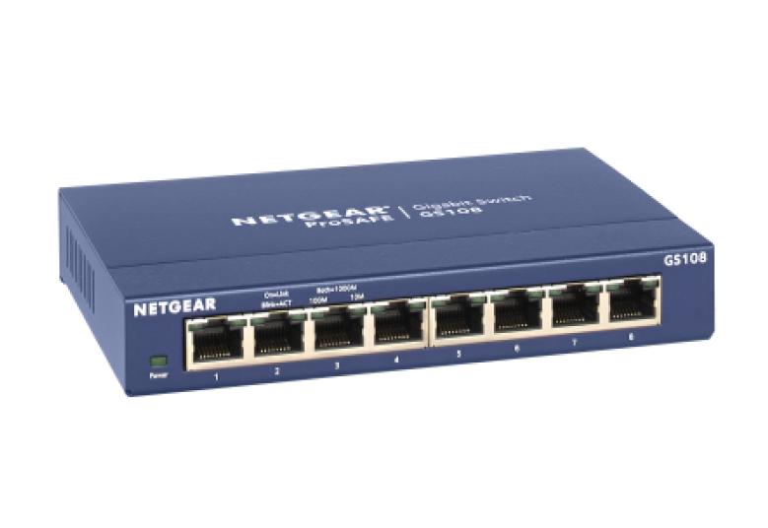


Monitoring Hardware
NETGEAR GS108
Intel NUC
Raspberry Pi

Slide 13
Lab Environment
Win10
Win7
Lab Network
192.168.66.0/24
.12
.10
Security Onion
Sensor
Lab vSwitch
Kali
Sniffing
Interface
.11
Mgmt vSwitch
.1
PFSense Firewall
Sensor Mgmt Internface
Internet

Slide 14
Demo

Slide 15
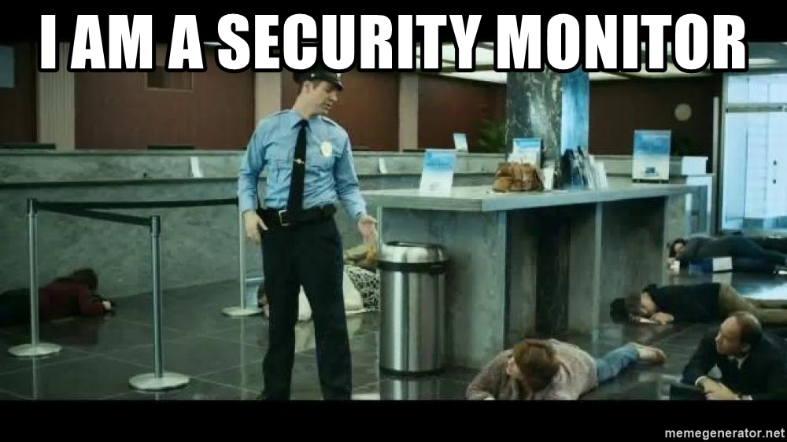
After Your Up and Running
False positive reduction
Alert Tuning
Grab windows event logs from hosts
Syslog from MAC/Linux devices
Install Host Based Intrusion Detection System (HIDS)
Add additional threat feeds
Add IDS Signature feeds

Slide 16
Other Uses
Malware Analysis and Training
https://www.malware-traffic-analysis.net/
Standalone Incident Response Tool
Ingest PCAP
Ingest Windows Event Logs
Ingest Syslog
Brad Duncan SecOnion Conf 2018 https://youtu.be/12PCO8_6-x4
Building a Lab for Detection | Justin Henderson
https://youtu.be/EtlI04dJWX4
Purple Teaming Framework
https://github.com/scythe-io/purple-team-exercise-framework

Slide 17
Links of Interest
Raspberry Pi sensors for home networks
https://www.youtube.com/watch?v=2bNmg1n6wTA
Corelight@ Home
https://go.corelight.com/corelight-at-home
Security Onion
https://securityonionsolutions.com/
Active Countermeasures How to use a Raspberry PI as a Network Sensor
https://www.activecountermeasures.com/raspberry_pi_sensor/How%20to%20use%20a%20Raspberry%20Pi%20as%20a%20network%20sensor.pdf
Security Onion Solutions
https://www.youtube.com/channel/UCNBFTyYCdjT5hnm7uW25vGQ
Zeek/CoreLight
https://www.youtube.com/c/Zeekurity/playlists
Black Hills Information Security
https://www.youtube.com/c/BlackHillsInformationSecurity
Zeek Week Conference
https://zeek.org/zeekweek2021/
Home Lab Ideas
https://github.com/aboutsecurity/blueteam_homelabs

Slide 18
Books and Blogs
Applied NSM by Chris Sanders
https://chrissanders.org/appliednsm/
Malware Analysis and Detection Engineering
https://www.apress.com/gp/book/9781484261927
SANS InfoSec Handlers Diary Blog
https://isc.sans.edu/

Slide 19
Folks to Follow on Twitter
Justin Henderson @SecurityMapper
John Hubbard @SecHubb
Eric Conrad @eric_conrad
Ismael Valenzuela @aboutsecurity
Lesley Carhart @hacks4pancakes
SwiftOnSecurity @SwiftOnSecurity
Security Onion @securityonion
Doug Burks @dougburks
John Strand @strandjs
Wes Lambert @therealwlambert
Chris Sanders @chrissanders88
The Zeek Network Security Monitor @Zeekurity
Olaf Hartong @olafhartong

Slide 20
WITAC 2122 - NETWORK MONITORING, SECURITY & FORENSICS
Introduction to NSM and NSM concepts
Planning NSM data collection
Sensor's platforms and management using Security Onion/RockNSM
Session and flow data leveraging Zeek/Suricata
Analysis of flow data using SiLK/Argus
Packet data collection and parsing, tools and techniques
Detection concepts and processes
Indications of compromise use and application
Network based IDS (NIDS) using Snort/Suricata
Zeek analysis
SIEM introduction using the Elastic Stack or (ELK)
Visualization of NSM data using ELK
Honeypots and Honeynet concepts and use
Threat Intelligence
NSM Analysis and Process
Based on Applied NSM by Chris Sanders

Slide 21
Questions

